Slide 1
Wheeler Heights Public School

Slide 2
Food at School
Recommendations
Breakfast
Lunchboxes
School Canteen
Crunch&Sip
Other programs
Being active
Notes:
At school we encourage healthy eating and drinking by
teaching in the classroom
providing a supportive environment
working with our families and community.
This slide lists some of the areas we will cover today.

Slide 3
Live Life Well @ School
Your school is part of the Live Life Well @ School (LLW@S) program and will have a key contact teacher/s trained for this program.
LLW@S is a joint initiative between the NSW Department of Education and NSW Ministry of Health that promotes physical activity and healthy eating.
Local Health Districts provide ongoing support to LLW@S trained schools and provide access to teaching resources, free professional development and workshops for teachers, canteen staff, P&C/P&F and other members of the school community.
Notes:
Ask your school how you can be involved in supporting it’s LLW@S activities. Parents can form a committee to help with healthy eating and physical activity initiatives in the school.

Slide 4
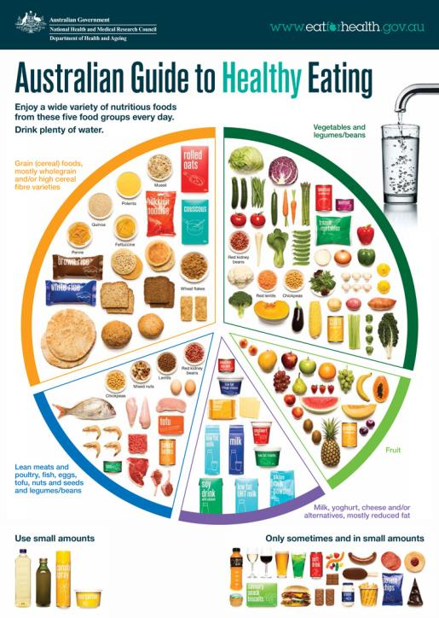
Notes:
The Australian Guide to Healthy Eating recommends eating a variety of foods from the 5 food groups. For more info: www.eatforhealth.gov.au. This is what nutrition recommendations are based on.

Slide 5
Development of healthy eating habits
Did you know?
Early experience with different flavours leads to later acceptance of new foods.
Acceptance of new foods does not occur the first time round.
Give children repeated opportunities to try new foods.
It may take up to ten times before the new food is accepted.
Children are more willing to try new vegetables if they see others choosing and eating them.
Notes:
Studies show that "early experience with a variety of flavours leads to more ready acceptance of new foods later. With the exception of sweet and salty foods, acceptance of new foods, does not occur instantly; however after repeated opportunities to consume new foods, liking for new food generally increases, producing increased intake, although 5 – 10 exposures are often required. "
Further to this studies show that "Children’s eating is modified by exposure and accessibility of foods; modelling behaviour of peers, siblings, and parents. (Birch LB, Development of Eating Behaviours Among Children and Adolescents).
Your perseverance will hopefully establish healthy eating habits that continue into adulthood.

Slide 6
Breakfast
Why Breakfast?
Provides energy and nutrients for the morning
Helps maintain a healthy weight
Helps learning, concentration & behaviour
Develops good eating habits
Notes:
Breakfast is important for student’s blood sugar levels to be able to concentrate in class, moderate behaviour and have the energy to engage in physical activity. It also reduces the desire to snack on high sugar and high fat foods.

Slide 7
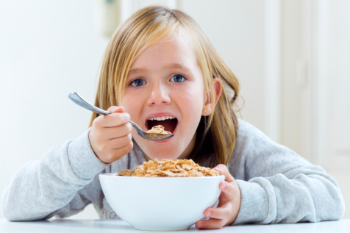
Breakfast
What is a Healthy Breakfast?
Wholegrain cereal, reduced fat milk & fruit
Wholegrain toast, spread & reduced fat milk
Notes:
For more info: http://www.nutritionaustralia.org/national/resource/kids-brainy-breakfast-ideas

Slide 8
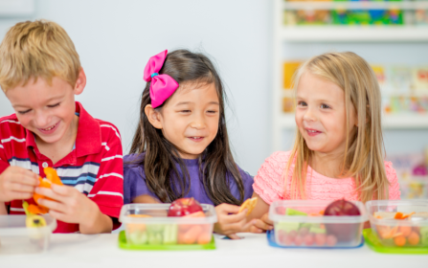
Lunchboxes
Children can eat up to 1/3 of their daily food intake at school
It is important to pack nutritious food to help your child
Concentrate and learn
Have healthy blood sugar levels to aid behaviour and mood regulation

Slide 9
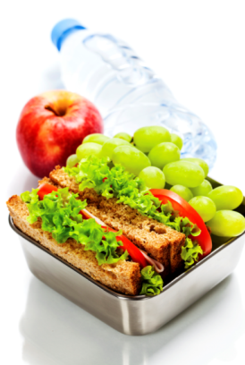
Lunchboxes
Kindy kids can be slow eaters and may want to play more than eat!
Keep lunchboxes simple (reduce choice)
Keep serves small
Ensure foods can be opened and eaten easily
Pack your own food using labelled reusable containers rather than buying small pre packed snack
– Good for the environment and your budget

Slide 10
Lunchboxes
Pack for:
Fruit break fresh fruit or veggies only
Recess e.g. whole grain crackers and cheese or pikelets and reduced fat milk drink (frozen)
Lunch e.g. chicken and salad sandwich or grated cheese and carrot wrap
Water to drink
Avoid packing an ‘occasional’ food everyday
Keep lunchboxes cold with icepacks or frozen water
Notes:
Lunchbox ideas and posters – http://www.healthykids.nsw.gov.au/parents-carers/healthy-eating-and-drinking/lunch-box-ideas.aspx

Slide 11
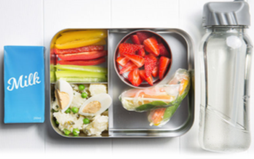
Lunchboxes
Receive a fortnightly e-newsletter with ideas for packing a healthy lunchbox.
To subscribe, send your first name, email address and postcode by:
Text to 0429 033 517
Email lookatlunches@gmail.com
Instagram @lookatlunches
Notes:
For healthy lunchbox inspiration, tips, recipes and ideas, Let’s Look at Lunches, sends a fortnightly e-newsletter that aims to take the challenge out of packing a healthy lunchbox.
Also see the Cancer Councils interactive healthy lunch box builder site at: http://www.healthylunchbox.com.au/

Slide 12
Sandwiches

Slide 13
Sandwiches
The Base
Choose a carbohydrate food as a base to satisfy appetites e.g. wholegrain, bread, pasta, rice.
The Filling
Select a high protein filling e.g. chicken, tuna, cheese
Add two or more varieties of vegetables for plenty of vitamins, minerals and dietary fibre
Notes:
The base
Use a variety of wholemeal, white, rye, pita, Lebanese bread, rolls, bagels, crackers, lavash, foccacia, English muffins, damper.(Use small serves for small appetites.)
The filling
Select a high protein filling from one of the following: lean beef, lamb or pork, ham, corned beef, rissoles, meatloaf, chicken breast, tinned tuna, salmon or sardines, cheese (e.g. cheddar, fetta, cream cheese, haloumi or cottage cheese), egg, baked beans, three-bean mix.
Vegetables and salad
Add two or more varieties for plenty of vitamins, minerals and dietary fibre.
Suggestions are: lettuce, tomato, cucumber, grated carrot, snow pea sprouts, celery, capsicum, mushrooms, Chinese cabbage, bok choy, zucchini, eggplant, beans, pitted olives, spinach, asparagus, pumpkin, sweet potato, avocado. Try avoid soggy fillings for lunch box sandwiches.
Handout : Tips to build a tasty, healthy lunch box.

Slide 14
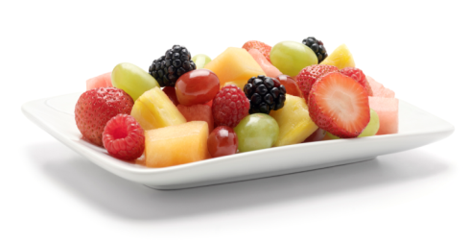
Healthy Snacks
Fresh fruit and vegetables (whole or chopped)
Wholegrain crackers, pita bread or rice cakes with
cheese
container of low fat dip e.g. hummus
vegemite
Scones, pikelets, English muffin
Plain popcorn
Reduced fat yoghurt
Sandwich
Dried fruit
Breadsticks
Notes:
These are some of the many examples of healthy snacks based on foods from the core food groups.
Resources on healthy snacks and snacks for 50cents-
http://www.healthpromotion.com.au/Lunchboxes/Lunchboxes_home.htm

Slide 15
Snacks to Avoid
Chocolate, lollies, jellies, liquorice, carob-based chocolate, yoghurt coating
Salty snacks such as potato chips or noodle snacks
Sugar sweetened drinks such as soft drinks, fruit drinks, cordials, sports drinks, energy drinks, flavoured mineral waters
Notes:
These foods are often high in sugar, salt and fats and provide few nutrients for growing bodies and minds to perform at their best.

Slide 16
Choose Water
Water is the best thirst quencher without, additional sugar and kilojoules
Make drinking water ‘the norm’ at school and at home
Children need at least 5 cups of fluid /day
Milk is good too!
It’s a good source of protein and calcium
Reduced fat milk is recommended for children over 2 years
Notes:
Make drinking water ‘the norm’
One of the key messages of LLW@S is Choose water as a drink. While it is the obvious thirst quencher for children (and adults alike) water has to compete with a broad range of sweetened drinks that can tempt us away from drinking water. If children develop a ‘sweet palate’ early on they will have a preference for juice and other sweetened drinks instead of water.
It is important that we promote ‘drinking water’ as the ‘norm’ . Children need at least 5 cups of fluid per day. Adults should aim for at least 8 cups per day. Tap water has added fluoride which helps children develop strong teeth.
Background information on MILK AND MILK ALTERNATIVES for presenter.
Children aged 4-11 years need 2-3 serves of milk or milk alternatives each day.
One serve is
1 cup (250ml) milk or soy milk (with added calcium)
200g (1 small carton) yoghurt
40g (2 slices) cheese
Note: Lactose intolerance may be an issue with some students. Lactose intolerance means they lack the enzyme, lactase, which is needed to digest lactose, a milk sugar. There are, however, many non-dairy milk sources available such as rice, oat, grain and soy milks. It is important that these are fortified with calcium.
Reduced fat milks are encouraged for children over 2 years. Reduced fat milks provide the same important nutrients as full cream milks (such as calcium and protein) but less saturated fat.
Plain reduced fat milks are preferred.
Flavoured reduced fat milks are a healthier choice than sugar sweetened drinks such as soft drinks, cordial etc.
Milk and milk alternatives also protect against tooth decay.

Slide 17
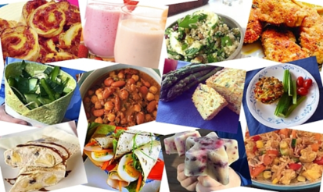
The School Canteen
New - NSW Healthy School Canteen Strategy
Supports school canteens to fill the menu with healthy ‘Everyday’ food and drinks and limit ‘Occasional’ items.
Notes:
The NSW Healthy School Canteen Strategy guides which foods and drinks can be sold in the canteen. Our school canteen provides tasty and healthy lunches, snacks and drinks to make the healthy choice, the easy choice for students.
There are 2 categories of canteen foods and drinks - Everyday and Occasional, based on the Australian Dietary Guidelines.
‘Everyday foods’ are the healthy choices, and these should fill the canteen menu.
‘Occasional foods’ are limited as they are less healthy – have moderate levels of fat, salt and sugar.
Under the Canteen Strategy, soft drinks and sugar sweetened drinks are banned for sale.

Slide 18
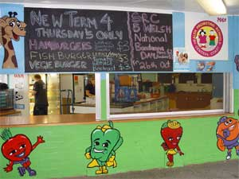
The School Canteen
Provides tasty and healthy lunches, snacks and drinks
Supports classroom nutrition messages
Introduces students to new or different foods
Volunteering is a great way to help your school
and meet other parents

Slide 19
The School Canteen
Manager | Shereen Lagasse
Open | Monday - Friday
Menu | School Newsletter, website and Flexischools
Lunch orders | Flexischools
Contact Shereen at whpscanteen@gmail.com to volunteer.
Notes:
Optional slide.
Add your school canteen photo and details where relevant.

Slide 20
Crunch & Sip Break
This is a set break to eat fruit or salad vegetables and drink water in the classroom.
✓Allowed | ✗ Not allowed
Fresh fruit (whole or chopped) Fresh vegetables e.g. celery, carrot sticks, beans Fruit canned in water, juice or ‘no added sugar’ e.g. peach slices | ‘Fruit products’ e.g. fruit leather, fruit roll-ups or similar Fruit lollies or jellies Fruit canned in syrup Drinks other than plain water
Notes:
Crunch & Sip Parent Handout : http://www.healthykids.nsw.gov.au/downloads/file/campaignsprograms/2014CrunchnSip-Parent-brochure.pdf
The Crunch and Sip break enables children to ‘refuel’ and rehydrate, which helps improve concentration and mental and physical performance.
Children rarely drink enough water and often forget to drink unless reminded.
Crunch&Sip® helps ensure the fruit or vegetables you pack are eaten when they otherwise may not be.
Send your child to school with a water bottle and some fruit or vegetables so they can participate in Crunch&Sip®

Slide 21
Food Allergies
Our school has a nut free policy
If your child has a severe allergic reaction to food, notify the school
Notes:
Optional slide – if your school has a child with a severe allergic reaction to food, please add information specific to your school.

Slide 22
Nutrition in Schools Policy
Schools to promote and model healthy eating and good nutrition in school programs and activities relating to or involving food and drink.
Teacher rewards
Extends beyond the canteen
School events
Class parties
School excursions & functions
Sports carnivals
Fundraising
Vending machines
Notes:
This is a mandatory nutrition policy: https://education.nsw.gov.au/policy-library/policies/nutrition-in-schools-policy
The Nutrition in schools policy aims to consolidate all aspects of a whole school approach to modelling and promoting good nutrition sending consistent messages to support students to make healthy eating choices.

Slide 23
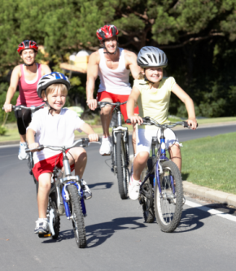
Be Active
Children need at least 60 minutes of moderate to vigorous physical activity every day.
Ways to be active
Try to walk, cycle, scooter or skate with your child to school or park the car 1km away from the school and walk the rest of the way.
Walk the dog
Play in the backyard – use your imagination e.g. build an obstacle course
Play at your local park or sports field
Join a physical activity group e.g. sport, dance.
Notes:
Optional handouts for parents:
Park and Walk resource : https://www.healthykids.nsw.gov.au/downloads/file/campaignsprograms/ParkandWalkorRide.pdf
Safe travel tips for parents and carers such as drop-off and pick-up by car , walking together to and from school:
http://roadsafety.transport.nsw.gov.au/downloads/keeping-our-kids-safe-around-schools.pdf
The physical activity recommendations are from the Australian Physical activity recommendations for 5-12 year olds. They can be found here:
http://www.health.gov.au/internet/main/publishing.nsf/Content/F892A8F8027FDD6DCA257C74000586C8/$File/Tips&Ideas-Children-5-12years.PDF
Tips for families to be more active : https://www.heartfoundation.org.au/active-living/active-families

Slide 24
Be Active: Screens Off
It is recommended that 5-12 years olds spend no more than two hours each day on the computer, small screen games or watching TV.
Effects of too much screen time:
Poor fitness, poor posture
Poor eye development
Sleep problems
Less time in creative and active play
Greater risk of being overweight as a child and adult
Social issues e.g. less time interacting with siblings & friends
Notes:
These recommendations are from the Australian Physical activity recommendations for 5-12 year olds.. They can be found here:
http://www.health.gov.au/internet/main/publishing.nsf/Content/F892A8F8027FDD6DCA257C74000586C8/$File/Tips&Ideas-Children-5-12years.PDF
Getting enough sleep is also important. Recommendations for primary school age children is 9-11 hours per night. They’re usually tired after school and might look forward to bedtime from about 7.30 pm. When your child sleeps well, he or she is more settled, happy and ready for school the next day. Getting enough sleep strengthens their immune system and could reduce the risk of infection and illness.
Sleep is vital for healthy children’s wellbeing, growth and development. Research is now looking at the link between reduced sleep and an increased risk of overweight and obesity.
For info see: http://raisingchildren.net.au/articles/school_age_sleep_nutshell.html/context/757

Slide 25
More Information
Healthy Kids: www.healthykids.nsw.gov.au
Healthy Kids Association: www.healthy-kids.com.au
Live Life Well @ School In the Northern Sydney area: www.nshealthpromotion.com.au www.twitter.com\nshealthprom

Slide 26
More Information
Parents’ Voice is a web based network of parents who wish to improve the food and physical activity environments for children in Australia.
www.parentsvoice.org.au
Notes:
Registering with this group gives access to current activities and media around healthy eating and physical activity for children.
The Parents’ Voice is supported by organisations such as the Cancer Council, Diabetes Australia (Vic), VicHealth and YMCA Victoria.
Parents can subscribe to a regular email update with current issues and stories of interest

Slide 27
Thank you
Brought to you by Wheeler Heights Public School &
Live Life Well @ School Health Promotion, Northern Sydney Local Health District
Adapted with permission from Health Promotion, Central Coast Local Health District

